Slide 1
12.6 Cross-Validating Kernelized Learners

Slide 2
In general, there is a large difference between the capacity of subsequent degrees D and D + 1 in models employing polynomial and Fourier kernels.
When N = 500, for example, there are 20,958,500 more polynomial units encapsulated in a degree D = 3 kernel matrix than a degree D = 2 kernel matrix.

Slide 3
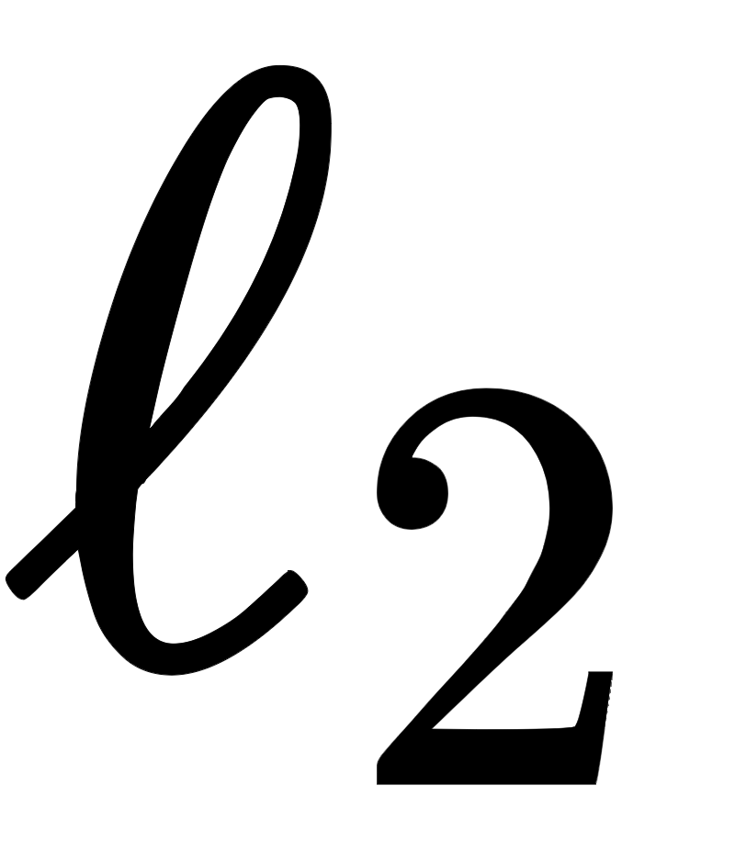

Because of this enormous combinatorial leap in capacity between subsequent degree kernels, cross-validation via regularization with the norm is common practice when employing polynomial and Fourier kernels.
Since the hyperparameter of the RBF kernel is continuous, models employing an RBF kernel can (in addition to the regularization approach) be cross-validated in principle by comparing various values of directly.

